Slide 1

Time Series Analysis

Slide 2
Python for Finance
It is now time to shift our focus to dealing with time series data!
A lot of our financial information is going to come in the form of some value plotted against a time series.

Slide 3
Python for Finance
While the concepts presented in this section of the course are very important, we may not use them often when working directly with our algorithmic trading models.

Slide 4
Python for Finance
In fact, one of our main reasons for covering these topics is so that in future sections of the course we can show why using some of these analysis techniques on stock information is actually NOT a good idea.

Slide 5
Python for Finance
It can be very tempting to use some of these techniques on financial data, but sometimes it’s actually not a good idea, and to understand why that is, we first need to understand the techniques themselves.

Slide 6
Python for Finance
So as an overall approach to this section, you should try to get a higher level understanding of some of these concepts, but don’t get concerned too much with the details (as far as future sections of the course are concerned).

Slide 7
Python for Finance
In this section we will discuss:
Time Series Basics
Statsmodels Python Library
ETS Models and Decomposition
EWMA Models
ARIMA Models

Slide 8
Time Series Basics

Slide 9
Python for Finance
Let’s begin discussing some important Time series concepts.
Time series data has particular properties, let’s take a look at some plots and discuss some important terms!

Slide 10
Python for Finance
Trends
Horizontal/Stationary
Upward
Downward

Slide 11
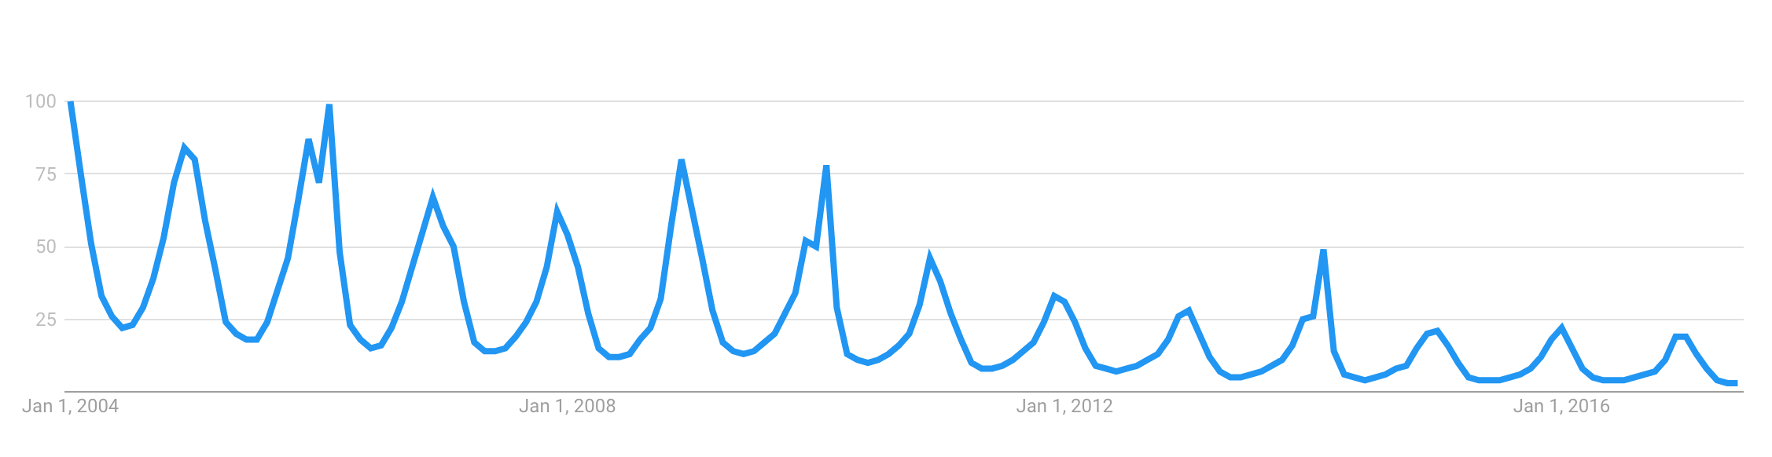
Python for Finance
Seasonality - Repeating trends
Google Trends - “Snowboarding”

Slide 12
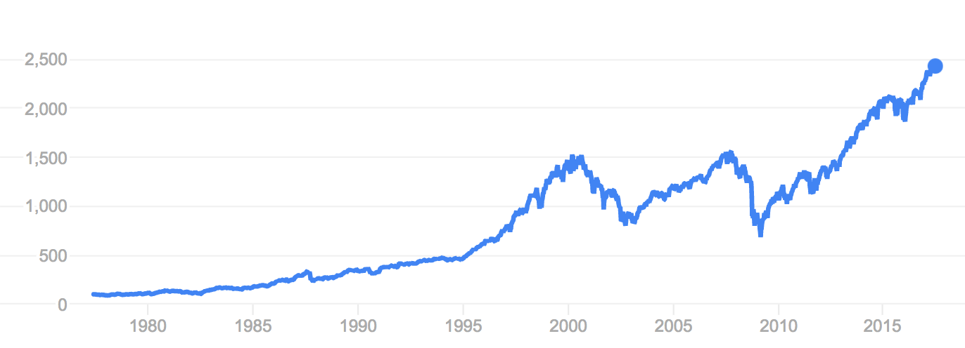
Python for Finance
Cyclical - Trends with no set repetition.
SP500

Slide 13
Python for Finance
Now that we understand some of the very basics, let’s begin to learn about the most popular library in Python for handling time series data, statsmodels!

Slide 14
Statsmodels

Slide 15
Python for Finance
The most popular library in Python for dealing with Time Series data is the statsmodels library.
It is heavily inspired by the R statistical programming language.

Slide 16
Python for Finance
Statsmodels is a Python module that allows users to explore data, estimate statistical models, and perform statistical tests.

Slide 17
Python for Finance
An extensive list of descriptive statistics, statistical tests, plotting functions, and result statistics are available for different types of data and each estimator.

Slide 18
Python for Finance
Statsmodels is already included in the provided environment file.
To manually install you can use:
conda install statsmodels

Slide 19
Python for Finance
Let’s explore the documentation and then run through a simple demonstration of what we can use statsmodels for in relation to time series data.

Slide 20
ETS Models

Slide 21
Python for Finance
For the next few lectures, we will discuss topics conceptually in slides.
Afterwards we will revisit these topics using Python and statsmodels to code through them!

Slide 22
Python for Finance
ETS Models (Error-Trend-Seasonality)
Exponential Smoothing
Trend Methods Models
ETS Decomposition
We’ll work with several of these with the python statsmodels library!

Slide 23
Python for Finance
ETS (Error-Trend-Seasonality) Models will take each of those terms for “smoothing” and may add them, multiply them, or even just leave some of them out.
Based off these key factors, we can try to create a model to fit our data.

Slide 24
Python for Finance
Time Series Decomposition with ETS (Error-Trend-Seasonality).
Visualizing the data based off its ETS is a good way to build an understanding of its behaviour.

Slide 25
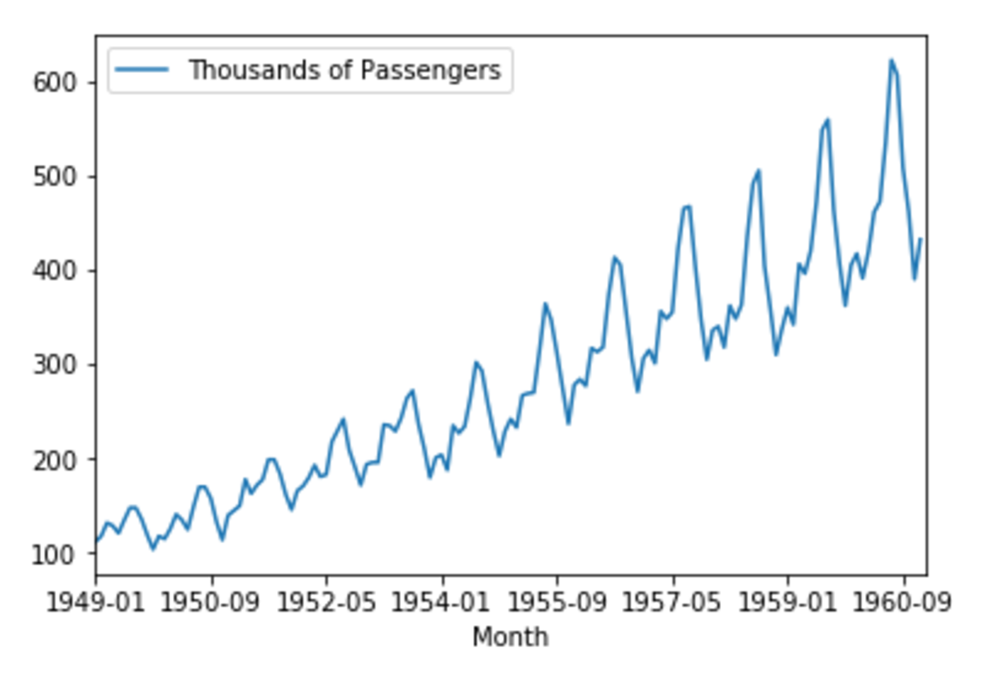
Python for Finance
ETS Decomposition - Airline Passengers

Slide 26
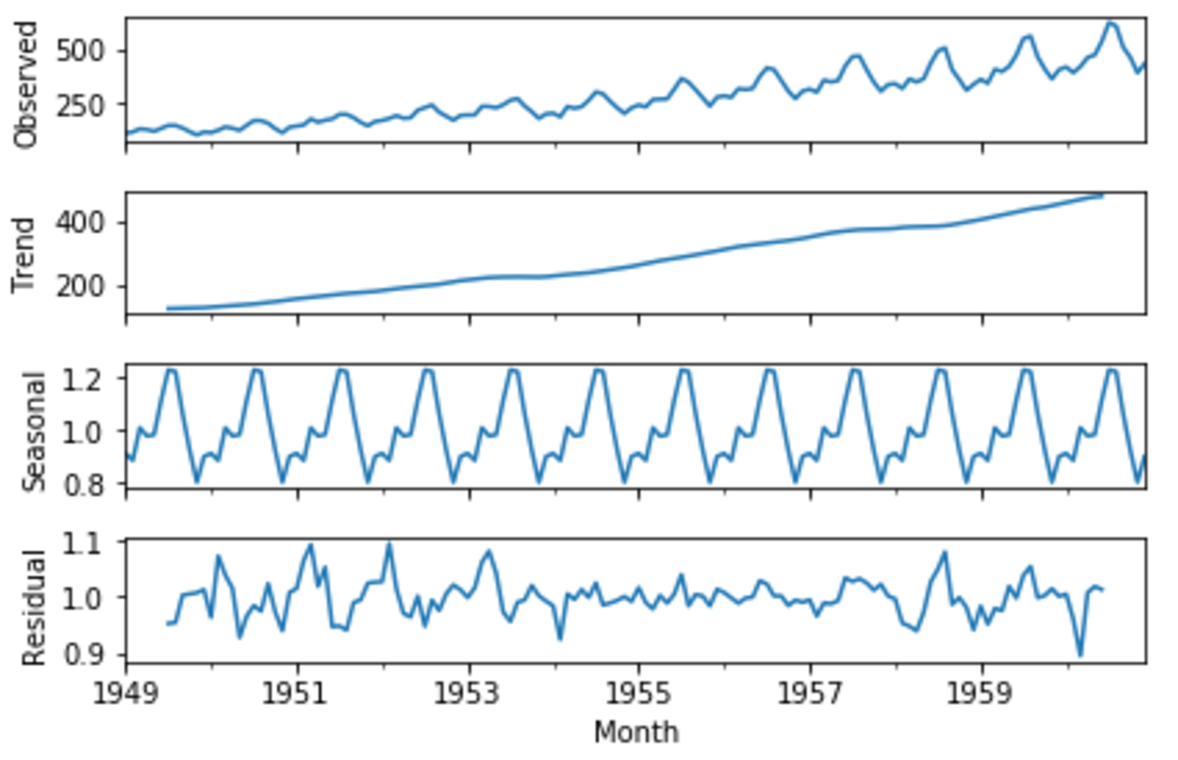
Python for Finance
ETS Decomposition - Airline Passengers

Slide 27
Python for Finance
Time Series Decomposition with ETS (Error-Trend-Seasonality).
Visualizing the data based off its ETS is a good way to build an understanding of its behaviour.

Slide 28
Python for Finance
We will visit Time Series Decomposition again when we discuss ARIMA models.
For now let’s move on to EWMA models!

Slide 29
EWMA Models

Slide 30
Python for Finance
We’ve previously seen how calculating simple moving averages can allow us to create a simple model that describes some trend level behavior of a time series, for example...

Slide 31
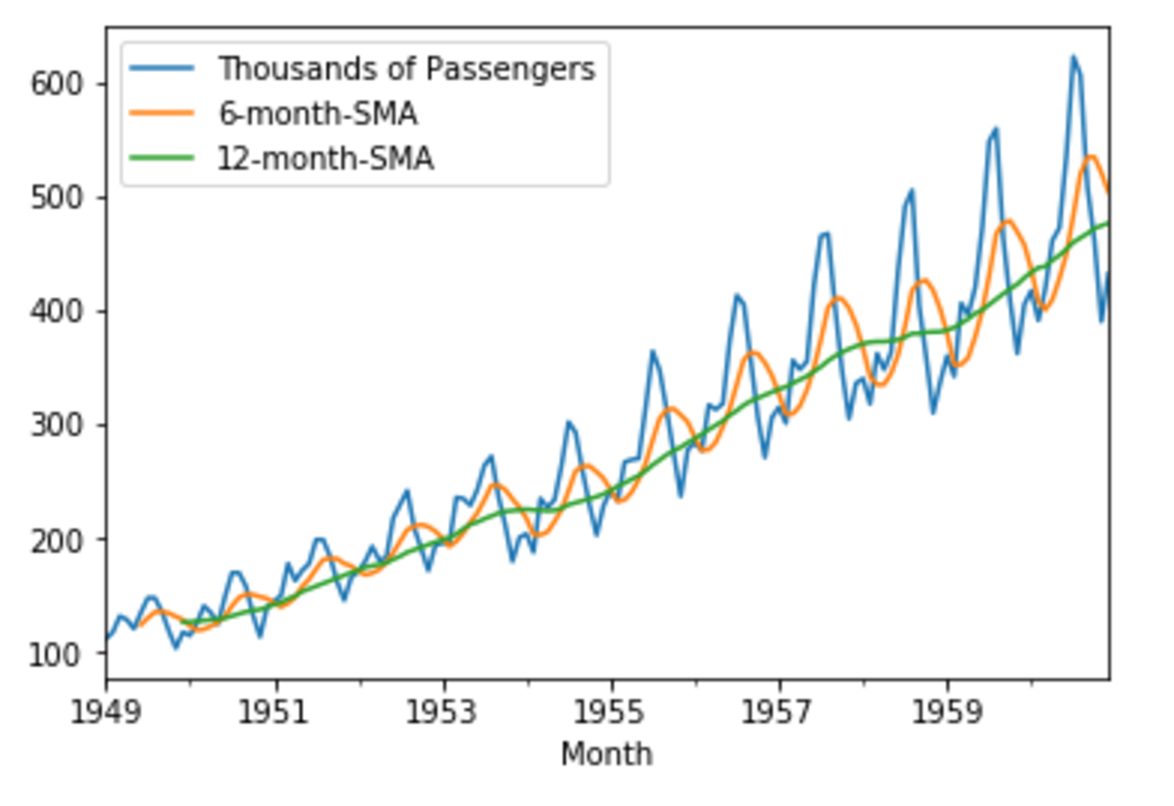
Python for Finance
SMA - Simple Moving Averages

Slide 32
Python for Finance
EWMA- Exponentially Weighted Moving Averages
Basic SMA has some "weaknesses".
Smaller windows will lead to more noise, rather than signal

Slide 33
Python for Finance
EWMA- Exponentially Weighted Moving Averages
Basic SMA has some "weaknesses".
It will always lag by the size of the window

Slide 34
Python for Finance
EWMA- Exponentially Weighted Moving Averages
Basic SMA has some "weaknesses".
It will never reach to full peak or valley of the data due to the averaging.

Slide 35
Python for Finance
EWMA- Exponentially Weighted Moving Averages
Basic SMA has some "weaknesses".
Does not really inform you about possible future behaviour, all it really does is describe trends in your data.

Slide 36
Python for Finance
EWMA- Exponentially Weighted Moving Averages
Basic SMA has some "weaknesses".
Extreme historical values can skew your SMA significantly

Slide 37
Python for Finance
EWMA- Exponentially Weighted Moving Averages
Basic SMA has some "weaknesses".
To help fix some of these issues, we can use an EWMA (Exponentially-weighted moving average).

Slide 38
Python for Finance
EWMA will allow us to reduce the lag effect from SMA and it will put more weight on values that occurred more recently (by applying more weight to the more recent values, thus the name).

Slide 39
Python for Finance
The amount of weight applied to the most recent values will depend on the actual parameters used in the EWMA and the number of periods given a window size.

Slide 40
Python for Finance
Let’s code out an example of using pandas to create EWMA in the next lecture!

Slide 41
EWMA Code Along

Slide 42
ETS Decomposition Code Along

Slide 43
ARIMA Models

Slide 44
Python for Finance
We will now discuss one of the most common time series models, ARIMA.
Please note, this is an optional section of the course.

Slide 45
Python for Finance
For various reasons we will discover later on, ARIMA models often don’t work well with historical stock data.
However, they are so fundamental to understanding time series analysis that it is still worth the time to go over them.

Slide 46
Python for Finance
ARIMA models can be complex!
Make sure to make full use of the various links and extra resources presented throughout this section if you want to later use ARIMA models for other problems.

Slide 47
Python for Finance
AutoRegressive Integrated Moving Average (ARIMA) model is a generalization of an autoregressive moving average (ARMA) model.

Slide 48
Python for Finance
Both of those models (ARIMA and ARMA) are fitted to time series data either to better understand the data or to predict future points in the series (forecasting).

Slide 49
Python for Finance
ARIMA (Autoregressive Integrated Moving Averages)
Non-seasonal ARIMA
Seasonal ARIMA

Slide 50
Python for Finance
We will start by discussing non-seasonal ARIMA models and then move on to seasonal ARIMA models.
The python examples at the end will be using seasonal ARIMA.

Slide 51
Python for Finance
ARIMA models are applied in some cases where data show evidence of non-stationarity, where an initial differencing step (corresponding to the "integrated" part of the model) can be applied one or more times to eliminate the non-stationarity.

Slide 52
Python for Finance
Differencing is actually a very simple idea, but let’s put it on hold for now, and talk a bit more about ARIMA!
We’ll touch back on differencing later on.
Let’s talk about the major components of ARIMA.

Slide 53
Python for Finance
Non-seasonal ARIMA models are generally denoted ARIMA(p,d,q) where parameters p, d, and q are non-negative integers.
Let’s discuss what these three components are!

Slide 54
Python for Finance
Parts of ARIMA model
AR (p): Autoregression
A regression model that utilizes the dependent relationship between a current observation and observations over a previous period

Slide 55
Python for Finance
Parts of ARIMA model
I (d): Integrated.
Differencing of observations (subtracting an observation from an observation at the previous time step) in order to make the time series stationary.

Slide 56
Python for Finance
Parts of ARIMA model
MA (q): Moving Average.
A model that uses the dependency between an observation and a residual error from a moving average model applied to lagged observations.

Slide 57
Python for Finance
Stationary vs Non-Stationary Data
To effectively use ARIMA, we need to understand Stationarity in our data.
So what makes a data set Stationary?
A Stationary series has constant mean and variance over time.

Slide 58
Python for Finance
A Stationary data set will allow our model to predict that the mean and variance will be the same in future periods.
Let’s take a look at a few examples!

Slide 59
Python for Finance
Mean needs to be constant
Stationary
Non-Stationary

Slide 60
Python for Finance
Variance should not be a function of time
Stationary
Non-Stationary

Slide 61
Python for Finance
Covariance should not be a function of time
Stationary
Non-Stationary

Slide 62
Python for Finance
There are also mathematical tests you can use to test for stationarity in your data.
A common one is the Augmented Dickey–Fuller test (we will see how to use this with Python’s statsmodels)

Slide 63
Python for Finance
If you’ve determined your data is not stationary (either visually or mathematically), you will then need to transform it to be stationary in order to evaluate it and what type of ARIMA terms you will use.

Slide 64
Python for Finance
One simple way to do this is through “differencing”.
The idea behind differencing is quite simple, let’s see an example...

Slide 65
Python for Finance
First Difference
Second Difference
Original Data
Time1 | 10
Time2 | 12
Time3 | 8
Time4 | 14
Time5 | 7
Time1 | NA
Time2 | 2
Time3 | -4
Time4 | 6
Time5 | -7
Time1 | NA
Time2 | NA
Time3 | -6
Time4 | 10
Time5 | -13

Slide 66
Python for Finance
You can continue differencing until you reach stationarity (which you can check visually and mathematically)
Each differencing step comes at the cost of losing a row of data.

Slide 67
Python for Finance
For seasonal data, you can also difference by a season.
For example, if you had monthly data with yearly seasonality, you could difference by a time unit of 12, instead of just 1.

Slide 68
Python for Finance
Another common technique with seasonal ARIMA models is to combine both methods, taking the seasonal difference of the first difference.

Slide 69
Python for Finance
With your data now stationary it is time to go back and discuss the p,d,q terms and how you choose them.
A big part of this are AutoCorrelation Plots and Partial AutoCorrelation Plots.
Let’s move on to discuss them!

Slide 70
AutoCorrelation Plots

Slide 71
Python for Finance
An autocorrelation plot (also known as a Correlogram ) shows the correlation of the series with itself, lagged by x time units.
So the y axis is the correlation and the x axis is the number of time units of lag.

Slide 72
Python for Finance
Let’s explain this idea of correlation with a simple example.
We’ll start off by trying to imagine how to calculate the plot value for x=1

Slide 73
Python for Finance
Imagine taking your time series of length T, copying it, and deleting the first observation of copy #1 and the last observation of copy #2.

Slide 74
Python for Finance
Now you have two series of length T−1 for which you calculate a correlation coefficient.
This is the value of the vertical axis at x=1 in your plots.

Slide 75
Python for Finance
It represents the correlation of the series lagged by one time unit.
You go on and do this for all possible time lags x and this defines the plot.
Let’s see some typical examples!

Slide 76
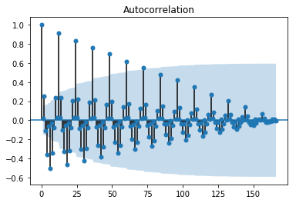
Python for Finance
Gradual Decline

Slide 77
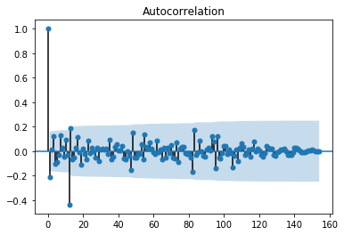
Python for Finance
Sharp Drop-off

Slide 78
Python for Finance
The actual interpretation and how it relates to ARIMA models can get a bit complicated, but there are some basic common methods we can use for the ARIMA model.

Slide 79
Python for Finance
Our main priority here is to try to figure out whether we will use the AR or MA components for the ARIMA model (or both!) as well as how many lags we should use.

Slide 80
Python for Finance
In general you would use either AR or MA, using both is less common.
When actually applying the AR and MA terms, you will set values of p or q.

Slide 81
Python for Finance
If the autocorrelation plot shows positive autocorrelation at the first lag (lag-1), then it suggests to use the AR terms in relation to the lag

Slide 82
Python for Finance
If the autocorrelation plot shows negative autocorrelation at the first lag, then it suggests using MA terms.
This will allow you to decide what actual values of p,d, and q to provide your ARIMA model.

Slide 83
Python for Finance
p: The number of lag observations included in the model.
d: The number of times that the raw observations are differenced
q: The size of the moving average window, also called the order of moving average.

Slide 84
Python for Finance
There are also partial autocorrelation plots!
These are a little more complicated than autocorrelation plots, but let’s show you the basics.

Slide 85
Python for Finance
In general, a partial correlation is a conditional correlation.
It is the correlation between two variables under the assumption that we know and take into account the values of some other set of variables.

Slide 86
Python for Finance
For instance, consider a regression context in which y = response variable and x1, x2, and x3 are predictor variables.
The partial correlation between y and x3 is the correlation between the variables determined taking into account how both y and x3 are related to x1 and x2.

Slide 87
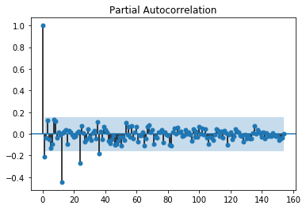
Python for Finance
Let’s see an example of what the plot can look like:

Slide 88
Python for Finance
Typically a sharp drop after lag "k" suggests an AR-k model should be used.
If there is a gradual decline, it suggests an MA model.

Slide 89
Python for Finance
Identification of an AR model is often best done with the PACF.
Identification of an MA model is often best done with the ACF rather than the PACF.
View the notebook and resource links for more details.

Slide 90
Python for Finance
Finally once you’ve analyzed your data using ACF and PACF you are ready to begin to apply ARIMA or Seasonal ARIMA, depending on your original data.
You will provide the p,d, and q terms for the model.

Slide 91
Python for Finance
An ARIMA will then take three terms p,d, and q. (We’ll see this in the coding example)
For seasonal ARIMA there will be an additional set of P,D,Q terms that we will see.

Slide 92
Python for Finance
Alright, now it is time to see all of this in action with Python and statsmodels!
Let’s get started!

Slide 93
ARIMA Code Along
Part Four

